Slide 1
Project Planning and Estimation
Chapter - 5

Slide 2
Introduction
A successful project is possible only through good project planning.
Project planning concentrates on estimating resources, time, budgets, and monitoring and controlling the activities of project management.
The project plan provides the basis for performing and managing the activities of a software project and addresses the commitment to stakeholder’s resource constraints and capabilities of the software project.
The main goal of the project plan is to establish a pragmatic strategy for controlling, tracking, and monitoring a project.
A typical project plan includes project scope, project estimates, schedule, requirements, risk management plan, control strategy, and various other plans.

Slide 3
Project Planning Activities
A general project plan includes the following project planning activities, beginning with project initiation to project completion.
  Defining business objectives and project scope
  Project estimations
  Project scheduling
  Resource planning
  Financial planning
  Staffing-level planning
  Development planning
  Project monitoring and control plan
  Risk management planning
  Quality assurance planning
  Configuration management planning
  Miscellaneous plans

Slide 4
Software Product, Project and Process
Software Product
A software product is the software system or application that is developed and delivered to users to solve a particular problem or perform specific tasks.
Examples:
Microsoft Office
Online Banking System
Hospital Management System
Mobile Banking App
ERP software
A college develops an Online Examination System. The completed system that is used by the students and teachers is a software product.

Slide 5
Software Product, Project and Process
Software Project
A software project is a planned set of activities undertaken to develop, modify, or maintain a software product within specified time, cost, scope, and quality constraints.
Example:
Developing an Online Examination System in six months with a team of 8 developers is a software project.
A project eventually produces a software product.

Slide 6
Software Product, Project and Process
Software Process
A software process is a systematic set of activities, methods, and practices used to develop, deliver, and maintain a software.
A typical software process includes:
Requirement Analysis – Identify what the customer needs.
Design – Plan the structure and architecture of the software.
Implementation/Coding – Write the program.
Testing – Find and correct defects.
Deployment – Deliver the software to users.
Maintenance – Modify and improve the software after delivery.

Slide 7
Software Metrics and Measurements
Examples of software process models:
Waterfall Model
Incremental Model
Spiral Model
Agile Model
Evolutionary Development Model

Slide 8
Software Metrics and Measurements
Software metric is the unit of measurement of software product, project, and process attributes.
Measuring software process or project provides a foundation to predict the parameters of project planning.
Effective use of metrics helps to measure product quality, manage projects, and assess processes.
Metrics provide necessary information for monitoring the progress of the project.
There are three types of metrics used in software projects:
  Product metrics,
  Process metrics,
  Project metrics.

Slide 9
Software Metrics and Measurements
Product metrics are used to measure product characteristics such as product quality factors (reliability, maintainability, defects, etc.) and product operational characteristics.
Process metrics assess the effectiveness of software processes and ensure conformance of standards and guidelines.
  Process metrics provide some attributes that help to improve the process maturity.
Project metrics are used to monitor the project plan, track progress, and estimate the project attributes.
  It measures the size, cost, efforts, schedule, and risks.

Slide 10
Project Size Estimation
Size measurement is the initial step for estimating the other attributes of software.
It is a direct measurement, which is based on the problem size.
There are various units of size measurement, such as
  Lines of code (LOC),
  Function point (FP),
  Token count (TC),
  Fuzzy logic sizing,
  Object Point (OP),
  Standard component sizing, and many more.

Slide 11
Project Size Estimation
  Lines of Code
  A line of code (LOC) metric is based on the measurement of the source lines of the code in a program.
  It is simply measured by counting the program header, declarations, executable, and non-executable lines in the source program.
  Comments lines, blank lines, and header lines are usually not considered during the LOC measurement.
  LOC is generally counted in kilo (thousand) line of codes (KLOC) per person-month (PM).
  Size measurement of the source lines helps to measure
    Defects per KLOC,
    Errors per KLOC,
    Dollars per KLOC,
    Pages of documentation per KLOC, and so on.

Slide 12
Project Size Estimation
Example of LOC
/* This program finds a substring in a given string */
#include<stdio.h>
#include<conio.h>
#include <string.h>
void main(int argc,char * argv[])
{ char *temp;
int start, end ;
clrscr();
if(argc==4)
{
start = atoi(argv[2]);
end = atoi(argv[3]);
strncpy(temp,argv[1]+start,end);
temp[end]='\0';
printf("entered string : %s\n ",argv[1]);
printf("\nsubstring : %s ",temp);
}
else
printf("incorrect arrgument ");
getch();
}
LOC = LOC counted as 17.

Slide 13
Project Size Estimation
Lines of Code : Disadvantages
  The value of LOC measurement varies with the programmer, programming language, and the project complexity.
  Every programmer has different technical skills, programming styles, and logical ability. Therefore, the LOC value may differ during estimation.
  Different programming languages have their different programming techniques. The actual number of the source lines may vary in programs.
  LOC only considers the source code. But some projects are highly complex and they need much effort at the design and analysis phases.

Slide 14
Project Size Estimation
Lines of Code : Disadvantages
  LOC is not suitable for component or reuse- based programming technologies where the components are considered as the unit of measurement.
  Also, it is very difficult to accurately estimate the project size from the requirement specification or project nature.
  There is a lack of standard tools for counting the source lines.
  The quality of code is the main focus for quality software, which is poorly considered during size measurement.

Slide 15
Project Size Estimation
Function Point Analysis
  To overcome the limitations of the LOC-based measurement, Alan Albrecht proposed another size estimation technique called the function point (FP) analysis.
  The size of the project is estimated on the basis of functions or services requested by the customer in the requirement specification.
  It is a structured technique that decomposes systems down into smaller components so that they can be better understood and analysed.
  It relies on the product features delivered to the customer.
  The actual number of function points can be verified at the end of each stage of a project.

Slide 16
Project Size Estimation
Function Point Analysis
- Function Point (FP) based estimation is a software estimation technique used to measure the functional size of software based on the functionality provided to the user, rather than the number of lines of code.
  FP-based estimations are based on the following five information domain values and their complexities in a particular project.
    Number of inputs
    Number of outputs
    Number of inquiries
    Number of logical files
    Number of external interfaces
  The value of each of these five information domains is collected and a subjective evaluation is performed to categorize them as simple, average, and complex.

Slide 17
Function oriented metrics (FP)
The idea behind FP metric is that the size of a software product is directly dependent on the number of different functions or features it supports.
They are derived using an empirical relationship based on countable measures of software’s information domain and assessment of complexity.
FP is computed based on following 5 information domain characteristics:
  Number of user inputs
  Number of user outputs
  Number of user inquiries
  Number of files
  Number of external interfaces

Slide 18
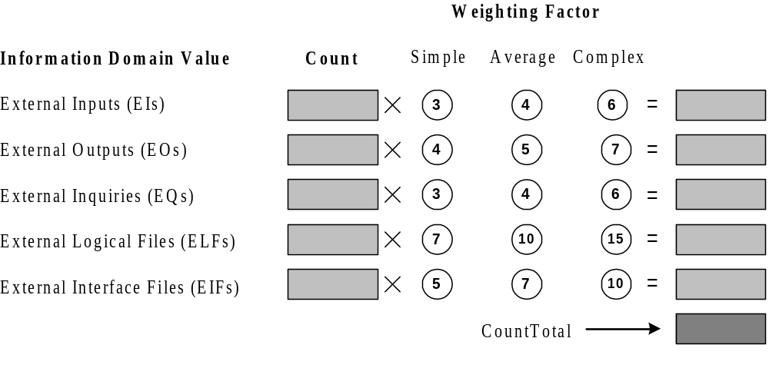
CountTotal in FP-Based Metric

Slide 19
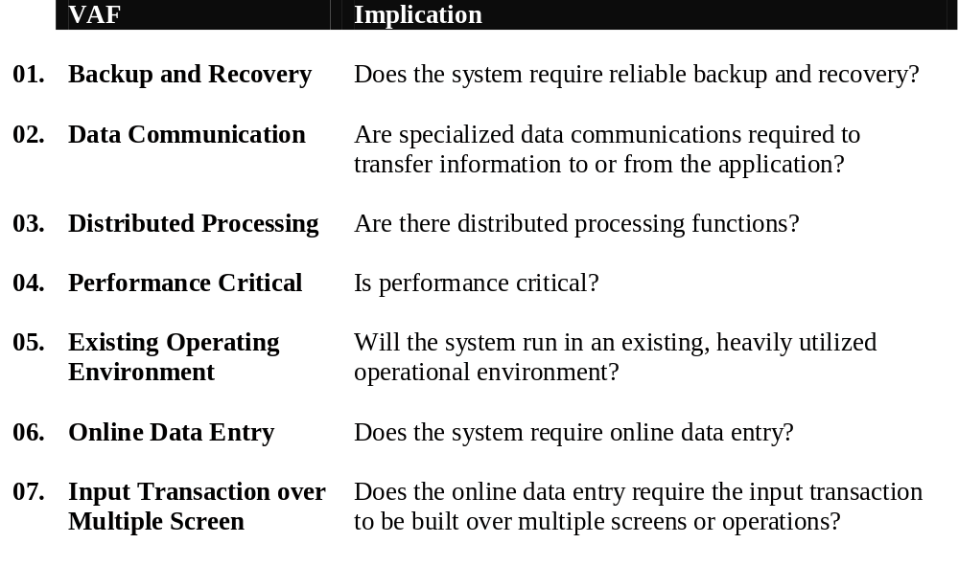
VAF in FP-Based Metric

Slide 20
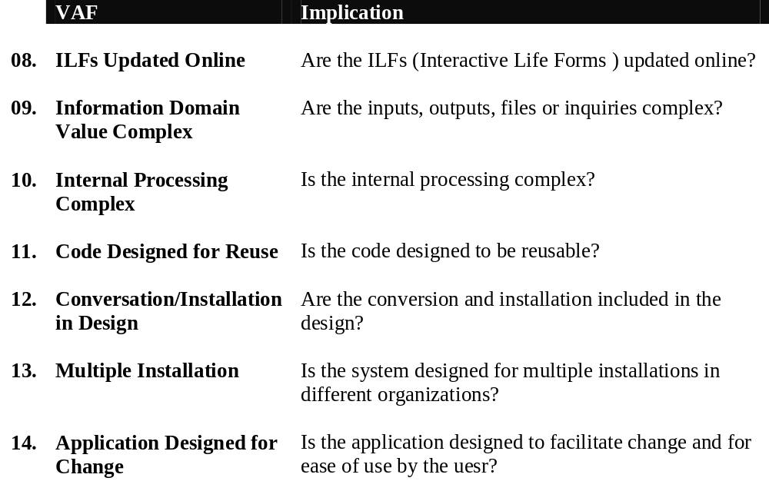
VAF in FP-Based Metric (Cont’d)

Slide 21
Values in FP-Based Metric
Each of the VAF is evaluated in scale of range from 0 (not important or applicable) to 5 (absolute essential)
The constant values in the equation of FP is decided empirically
The values for weighting factors that are applied to information domain counts are also determined empirically

Slide 22
Project Size Estimation: FP-Based Metric
To compute function points (FP), the following empirical relationship is used
Here CountTotal is the sum of all FP entries
The F_{i} (i = 1 to 14) are value adjustment factor (VAF)

Slide 23
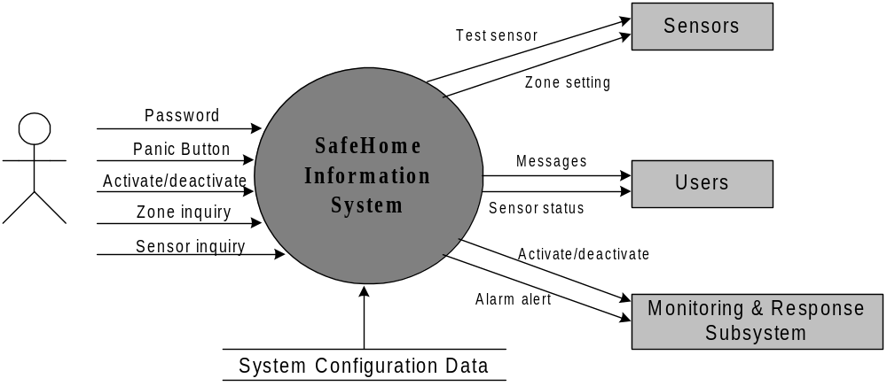
An Example of FP-Based Estimation

Slide 24
An Example of FP-Based Estimation
External inputs
Password
Panic Button
Activate/deactivate
External outputs
Messages
Sensor status
External inquiries
Zone inquiry
Sensor inquiry
Internal Logical file
System configuration file
External Interface Files
Test sensors
Zone setting
Activate/deactivate
Alarm alert

Slide 25
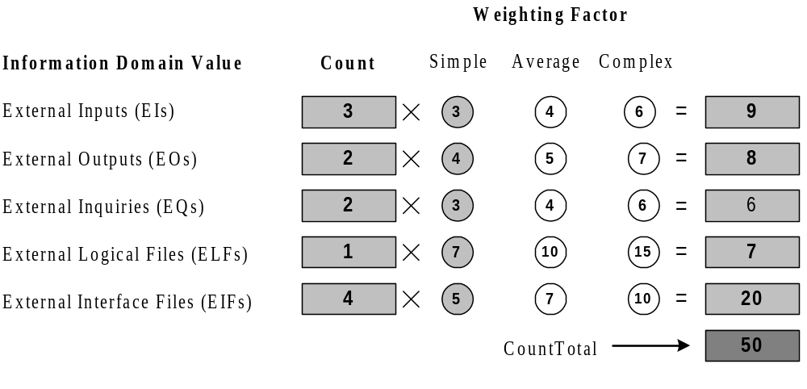
An Example of FP-Based Estimation
External inputs
Password
Panic Button
Activate/deactivate
External outputs
Messages
Sensor status
External inquiries
Zone inquiry
Sensor inquiry
Internal Logical file
System configuration file
External Interface Files
Test sensors
Zone setting
Activate/deactivate
Alarm alert

Slide 26
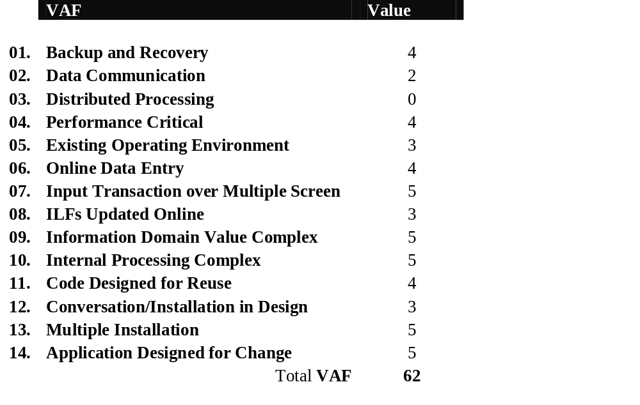
An Example of FP-Based Estimation

Slide 27
An Example of FP-Based Estimation
The estimated number of FP can be derived as
= 50 X [0.65 + 0.01 X 62]
= 63.5
Once FP is known, effort can be estimated using an organization's historical productivity:
Effort=FP × Effort per FP​
For example, if historical data indicates 8 person-hours per FP:
Effort = 63.5 × 8 = 508 person-hours

Slide 28
Project Size Estimation
Productivity = fp/Effort

Slide 29
Project Size Estimation
Example 4.1
Compute the FP value for the grade calculation of students. Assume that it is an average complexity size project. The information domain values are as follows: number of inputs = 13, number of outputs = 4, number of inquiries = 2, number of external files = 5, number of interfaces = 2. The total value of complexity adjustment attributes (VAF) is 13.

Slide 30
Project Size Estimation
Function Point Analysis: Benefits
The FP computation is useful to find other metrics of the project such as defect per FP, cost per FP, FP per hour productivity, and so on.
Independent of programming language
Function points measure functionality rather than lines of code, so they can be used for Java, Python, C++, etc.
Can be used early in development
Estimation can be performed from requirements and specifications, even before coding begins.
User-oriented measurement
It measures software based on the functionality delivered to the user, making it easier to relate estimation to business requirements.
Useful for effort and cost estimation
Function points can be combined with historical productivity data to estimate development effort and project cost.

Slide 31
Project Size Estimation
Function Point Analysis: Benefits
Better comparison between projects
Projects developed using different programming languages or technologies can be compared using function points.
Supports productivity measurement
Useful for project planning
FP estimates can help managers plan resources, schedules, staffing, and budgets.
Less dependent on programmer coding style
Unlike LOC-based estimation, function points are not significantly affected by coding practices or programming language.
Supports historical analysis
Organizations can maintain historical FP and effort data and use it to improve future estimates.
Useful for maintenance and enhancement projects
Function points can also be used to measure the size of changes made to existing software.

Slide 32
Project Size Estimation
Function Point Analysis: Benefits
Function Point-based estimation is advantageous because it is user-oriented, language-independent, applicable early in the software life cycle, and useful for estimating effort, cost, productivity, and project resources.

Slide 33
Project Size Estimation
Function Point Analysis: Disadvantages
Complex to calculate
Identifying and classifying inputs, outputs, files, and inquiries requires experience and careful analysis.
Subjective judgment
Determining whether a function has low, average, or high complexity can depend on the estimator's judgment.
Requires trained personnel
Accurate Function Point estimation generally requires people who understand the FPA rules and have sufficient experience.
Not suitable for all types of software
It works well for business and information-processing systems but may be less suitable for real-time, scientific, embedded, or algorithm-intensive software.

Slide 34
Project Size Estimation
Function Point Analysis: Disadvantages
Time-consuming for large projects
A detailed function-point analysis can require considerable time, especially for complex systems.
Does not directly measure code size
Function points measure functionality, not the actual number of lines of code or programming complexity.
Difficulty with changing requirements
Frequent changes in requirements can require repeated Function Point calculations.

Slide 35
Project Size Estimation
Function Point Analysis: Disadvantages
Limited consideration of technical complexity
Two systems with similar functional size may have very different technical difficulties, performance requirements, or architectural complexity.
Accuracy depends on requirements
If requirements are incomplete or unclear, the resulting Function Point estimate may be inaccurate.
May require adjustment for different environments
Historical productivity data may not apply directly when the development technology, team, or project environment changes.

Slide 36
Project Size Estimation
Feature Point Metric
The feature point metric is an extension of the function points that includes the algorithmic complexity of the software.
An algorithm is a step-wise procedure with defined rules which are designed to solve a significant computational problem.
For example, a sine routine can be considered as an algorithm. Each algorithm is assigned a weight ranging from 1 (elementary) to 10 (sophisticated algorithms).
The feature point metric is the weighted sum of algorithms plus the function points.
It is especially useful for systems with a few inputs/outputs and a high algorithmic complexity, such as mathematical software, CAD, AI, discrete simulations, and military applications.

Slide 37
Effort Estimation
Effort estimation predicts how much time is required to complete a project, how much it costs, and how many engineers are required for completing the project.
More accurate estimates are possible as the project proceeds, i.e., during the feasibility study, requirement analysis, design, and subsequent phases.
There are various factors that affect cost estimation such as, capability of engineers, product complexity, product size, availability of delivery time, required reliability, and the level of technology.
Cost estimation can be performed either in a top-down or a bottom-up manner.

Slide 38
Effort Estimation Approaches
Top-down approach estimates the project cost globally by estimating the system level costs of the overall project size.
The system level cost includes the cost of resources for product development, configuration management, quality assurance, integration, installation, and deployment.
It requires minimum project details and it is usually faster and easier to adopt.
This approach does not consider other technical requirements for specific modules.
In case of underestimation or overestimation, an inaccurate result of effort estimate may be produced that may lead to an under-budget or over-budget project.

Slide 39
Effort Estimation Approaches
In the bottom-up approach, the cost of individual modules is estimated and then all these costs are integrated to estimate the overall project cost.
This approach can produce more accurate estimate due to the consideration of discrete parts for estimation.
It is more stable as estimation errors in modules can be rectified and balanced. But someone may overlook the system-level costs, such as quality assurance cost, configuration management cost, etc.
Size estimate is the primary need for both top-down and bottom-up approaches.

Slide 40
Effort Estimation Techniques
There are different techniques for effort estimation. Some of the most popular estimation techniques are
  Estimation by analogy,
  Delphi estimation,
  Algorithmic cost modelling, and
  Analytical techniques

Slide 41
Effort Estimation Techniques
Estimation by analogy
The estimation-by-analogy technique is based on the experiences of the past projects.
The estimation-by-analogy method involves an expert for finding the analogous situations so as to give his opinion.
This technique follows a top-down estimation approach.
The project to be assessed is characterized on certain factors that become the basis for finding similar or analogous projects which have been completed and their efforts are known.
Then the proposed project is compared with the previously completed similar projects.

Slide 42
Effort Estimation Techniques
Estimation by analogy: Problems
The estimators have to determine how best they can characterize the projects in terms of application domain, the number of inputs, the number of distinct entities referenced, the number of screens, and so on.
Another problem after project characterization is to determine similarity: how much confidence we can place in the analogies and how many projects need to be compared.
A few analogies might lead to maverick projects being used and too many analogies might lead to dilution of the effect of the closest analogies.
Lastly, it is very difficult what variables should be considered to estimate the new projects with known effort values from the analogous projects.
Means and weighted means can give more influence to the closer analogies.

Slide 43
Effort Estimation Techniques
Delphi estimation
Delphi cost estimation is a group consensus technique that relies on expert judgment and follows the top-down estimation approach with certain features of the bottom-up approach.
The coordinator interacts with experts for providing necessary information and documents.
The estimators go through the requirement document and make their estimates anonymously.
The coordinator compiles the estimation reports and distributes a summary of the estimation responses.
The estimation report specifies any unusual characteristic noted by the estimators.
The coordinator can call a group meeting of experts to discuss points if the estimates vary widely.
The estimation is iterated for as many rounds as appropriate for an accurate estimate.

Slide 44
Effort Estimation Techniques
Delphi estimation: Benefits
The experts use their experiences of the past projects to assess the factors in the proposed project.
Each expert applies their distinguished expertise and knowledge to assess the project.
There is less chance for bias due to group consensus.
There are rare chances of bias if only a few experts, maybe one or two, are involved in the estimation process.
Delphi estimation: Problems
The team may take pain in gathering some information that may not be useful for estimation in the proposed project.
This method is very difficult to quantify.
It is hard to document the factors used by the experts or expert groups.

Slide 45
Effort Estimation Techniques
Algorithmic cost models
Algorithmic cost models use size estimation model, which is based upon certain project parameters.
The value of these parameters depends on the project type:
  Organic projects are very simple and can be developed with a small-size team. A simple data processing system is a good example of the organic category.
  Embedded projects are very complex and have stringent constraints, for example, flight control system for aircraft.
  Semidetached projects are intermediate in size and complexity. A transaction processing system with fixed requirements for terminal hardware and database software is an example of the semi-detached category.

Slide 46
Effort Estimation Techniques
COCOMO Model
COCOMO (COnstructive COst MOdel) is an algorithmic cost estimation technique proposed by Boehm, which works in a bottom-up manner.
It is designed to provide some mathematical equations to estimate software projects.
These mathematical equations are based on historical data and use project size in the form of KLOC.
The COCOMO model uses a multivariable size estimation model for effort estimation.
A multivariable model depends on several variables, such as development environment, user involvement, memory constraints, technique used, etc.

Slide 47
Effort Estimation Techniques
COCOMO Model
A single variable model is based only upon the size of the project, which is given as
Effort = a × Size ^{b}
The constants a and b are derived from the historical data of the past projects in the organizations.
Project category | a | b
Organic | 3.2 | 1.05
Semidetached | 3.0 | 1.12
Embedded | 2.8 | 1.20

Slide 48
Effort Estimation Techniques
COCOMO Model
COCOMO estimation is a family of hierarchical models, which includes
  Basic,
  Intermediate, and
  Detailed COCOMO models.
Each of the models initially estimates efforts based on the total estimated KLOC.

Slide 49
Effort Estimation Techniques
Basic COCOMO Model
The basic COCOMO model estimates effort in a function of the estimated KLOC in the proposed project.
The basic COCOMO model is very simple, quick, and applicable to small to medium organic-type projects. It is given as follows:
Development effort (E) = a × (KLOC) ^{b}
Development time (T) = c × (E) ^{d}
Where a, b, c, and d are constants and these values are determined from the historical data of the past projects.
The development time (T) is calculated from the initial development effort (E).

Slide 50
Effort Estimation Techniques
Basic COCOMO Model
The values of c and d for organic-, semidetached-, and embedded-type projects are shown in the Table below:-
Project category | c | d
Organic | 2.5 | 0.38
Semi-detached | 2.5 | 0.35
Embedded | 2.5 | 0.32

Slide 51
Basic COCOMO Model
Example 4.2
Assume that a system for simple student registration in a course is planned to be developed and its estimated size is approximately 10,000 lines of code. The organization is proposed to pay Rs. 25000 per month to software engineers. Compute the development effort, development time, and the total cost for product development.

Slide 52
Basic COCOMO Model
Solution 4.2:
The project can be considered as an organic project. Thus, from the basic COCOMO model,
Development effort (E) = 3.2 × (10) ^{1.05} = 35.90 PM
Development time (T) = 2.5 × (35.90) ^{0.38} = 9.747 months
Total product development cost = Development time × Salaries of engineers
= 9.747 × 25000
= Rs. 2,43,675

Slide 53
Effort Estimation Techniques
Intermediate COCOMO Model
Boehm has introduced 15 cost drivers, considering the various aspects of product development environment.
These cost drivers are used to adjust the project complexity for estimation of effort and these are termed as effort adjustment factors (EAF).
These cost drivers are classified as computer attributes, product attributes, project attributes, and personnel attributes.
The intermediate COCOMO model estimates the initial effort using the basic COCOMO model.
Then the EAF is calculated as the product of 15 cost drivers.

Slide 54
Intermediate COCOMO Model
Cost drivers
Cost drivers | Ratings
 | Very low | Low | Nominal | High | Very high | Extra high
Product attributes
Software reliability (RELY) | 0.75 | 0.88 | 1.00 | 1.15 | 1.40 | -
Size of database (DATA) | - | 0.94 | 1.00 | 1.08 | 1.16 | -
Product complexity (CPLX) | 0.70 | 0.85 | 1.00 | 1.15 | 1.30 | 1.65
Hardware attributes
Run-time performance constraints (TIME) | - | - | 1.00 | 1.11 | 1.30 | 1.66
Memory storage constraints (STORE) | - | - | 1.00 | 1.06 | 1.21 | 1.56
Virtual machine volatility (VIRT) | - | 0.87 | 1.00 | 1.15 | 1.30 | -
Required turnaround time (TURN) | - | 0.87 | 1.00 | 1.07 | 1.15 | -
Personnel attributes
Analyst capability (ACAP) | 1.46 | 1.19 | 1.00 | 0.86 | 0.71 | -
Applications experience (AEXP) | 1.29 | 1.13 | 1.00 | 0.91 | 0.82 | -
Programmer capability (PCAP) | 1.42 | 1.17 | 1.00 | 0.86 | 0.70 | -
Virtual machine experience (VEXP) | 1.21 | 1.10 | 1.00 | 0.90 | - | -
Programming language experience (LEXP) | 1.14 | 1.07 | 1.00 | 0.95 | - | -
Project attributes
Modern programming practices (MODP) | 1.24 | 1.10 | 1.00 | 0.91 | 0.82 | -
Use of software tools (TOOL) | 1.24 | 1.10 | 1.00 | 0.91 | 0.83 | -
Development schedule (SCHED) | 1.23 | 1.08 | 1.00 | 1.04 | 1.10 | -

Slide 55
Effort Estimation Techniques
Intermediate COCOMO Model
Total effort is determined by multiplying the initial effort with the total value of EAF. The computation steps are summarized below.
    Development effort (E):
      Initial effort (E_{i}) = a × (KLOC) ^{b}
      EAF = EAF₁ × EAF₂ ×... × EAF_{n}
      Development effort (E) = E_{i} × EAF
    Development time (T) = c * (E) ^{d}

Slide 56
Intermediate COCOMO Model
Example 4.3
Suppose a library management system (LMS) is to be designed for an academic institution. From the project proposal, the following five major components are identified:
Online data entry - 1.0 KLOC
Data update - 2.0 KLOC
File input and output - 1.5 KLOC
Library reports - 2.0 KLOC
Query and search - 0.5 KLOC
The database size and application experience are very important in this project. The use of the software tool and the main storage is highly considerable. The virtual machine experience and its volatility can be kept low. All other cost drivers have nominal requirements. Use the COCOMO model to estimate the development effort and the development time.

Slide 57
Intermediate COCOMO Model
Solution 4.3:
The LMS project can be considered an organic category project. The total size of the modules is 7 KLOC. The development effort and development time can be calculated as follows:
Development effort
Initial effort (E_{i}) = 3.2 × (7) ^{1.05} = 24.689 PM
EAF = 1.16 × 0.82 × 0.91 × 1.06 × 1.10 × 0.87 = 0.878
Total effort (E) = E_{i} * EAF
= 24.689 × 0.878
= 21.677 PM
Development time (T) = 2.5 × (E) ^{0.38} month
= 2.5 (21.677) ^{0.38} month
= 8.0467 month

Slide 58
Effort Estimation Techniques
Detailed COCOMO Model
The detailed COCOMO model inherits all the features of the intermediate COCOMO model for the overall estimation of the project cost.
The detailed COCOMO model uses different effort multipliers (cost drivers) for each phase of the project.
Phase-wise effort multipliers provide better estimates than the intermediate model.
The detailed COCOMO model defines following life cycle phases for effort distribution:
  Requirements and product design,
  system design,
  detailed design,
  code and unit test, and
  integration and test.

Slide 59
Detailed COCOMO Model
Table 4.4: Phase-wise distribution of the development effort and time
Project type and size | Requirements and product design | Detailed design | Code and unit test | Integration and test
Percentage-wise distribution of the development effort
Organic (2 KLOC) | 16 | 26 | 42 | 16
Organic (32 KLOC) | 16 | 24 | 38 | 22
Semi-detached (32 KLOC) | 17 | 25 | 33 | 25
Semi-detached (128 KLOC) | 17 | 24 | 31 | 28
Embedded (128 KLOC) | 18 | 25 | 26 | 31
Embedded (320 KLOC) | 18 | 24 | 24 | 34
Percentage-wise distribution of the development time
Organic (2 KLOC) | 19 | 24 | 39 | 18
Organic (32 KLOC) | 19 | 21 | 34 | 26
Semi-detached (32 KLOC) | 26 | 21 | 27 | 26
Semi-detached (128 KLOC) | 27 | 19 | 25 | 29
Embedded (128 KLOC) | 36 | 18 | 18 | 28
Embedded (320 KLOC) | 38 | 16 | 16 | 30

Slide 60
Detailed COCOMO Model
The linear interpolation formula to approximate the percentage of effort in a particular phase with respect to estimated project size can be used as follows,
Phase-wise % of effort =
E1 + ((E2 - E1)/ (S2-S1)) * estimated project size
Where, S1 and S2 are the lower and upper known project sizes; and E1 and E2 are lower and upper percentage of efforts for S1 and S2, respectively.
Similarly, development time duration can also be calculated using interpolation formula.

Slide 61
Detailed COCOMO Model
Solution 4.4:
There are five components in the organic project discussed in Example 4.3: online data entry, data update, file input and output, library reports, query and search. The estimated effort (E) is 21.6785 PM and estimated time (T) is 8.0467. The total size is 7 KLOC, which is between 2 KLOC and 32 KLOC.
Phase wise actual percentage of development effort can be calculated as follows:
Requirements and product design(%) = 16 +((16 – 16)/(32-2))×7= 16%
Effort = 0.16 × 21.677 PM = 3.468 PM
Detailed design (%) = 26 + ((24-26) / (32-2)) × 7 = 26%
Effort = 0.26 × 21.677 PM = 5.636 PM
Code and unit test (%) = 42 + ((38 - 42) / (32 - 2)) × 7 = 41%
Effort = 0.41 × 21.677 PM = 8.888 PM
Integration and test (%) = 16 + ((22-16) / (32 - 2)) × 7 = 17%
Effort = 0.17 × 21.677 PM = 3.685 PM

Slide 62
Detailed COCOMO Model
Solution 4.4:
Similarly, phase-wise actual percentage of development time duration can be calculated as follows:
Requirements and product design (%)= 19 + ((19 - 19) / (32 - 2)) × 7 = 19% Time duration = 0.19 × 8.0467 = 1.5289 M
Detailed design (%) = 24 + ((21-24) / (32-2)) × 7 = 23%
Time duration = 0.23 × 8.0467 = 1.8507 M
Code and unit test (%) = 39 + ((34 - 39) / (32 - 2)) × 7 = 38%
Time duration = 0.38 × 8.0467 = 3.0577 M
Integration and test (%) = 18 + ((26-18) / (32 - 2)) × 7 = 20%
Time duration = 0.20 × 8.0467 = 1.6094 M

Slide 63
Effort Estimation Techniques
COCOMO I Model
The basic, intermediate, and detailed COCOMO models are in the category of COCOMO I and these are collectively known as COCOMO 81.
The COCOMO I models were developed to estimate the effort, schedule, and cost of a software project.
The three variations of COCOMO I use different types of parameters for estimation.
These models are helpful to produce repeatable estimations.
It is unable to deal with exceptional conditions, such as exceptional teamwork, exceptional people involved in the estimation process, etc.
Rough sizing of projects and inaccurate cost driver rating will result in an inaccurate estimation.

Slide 64
Effort Estimation Techniques
COCOMO II Model
COCOMO II is an extension to the original COCOMO 81 model.
These changes have changed the development processes from linear to spiral and one-go to incremental way for developing simple to complex projects.
Programming techniques and technologies have moved from conventional to component-based software development.
Thus, a new, enhanced COCOMO II model was proposed to overcome the limitations of COCOMO 81.
It consists of sub-models, each one providing unique features for project planning and design process.
  The applications composition model,
  Early design model,
  Post-architecture model, and
  Reuse model.

Slide 65
Effort Estimation Techniques
Application Composition Model
The application composition model is best suitable for prototyping projects and projects where there is extensive reuse of components.
It involves prototyping efforts to resolve unexpected risks related to GUI, device interaction, performance, or technology maturity.
The estimation is based on the standard estimates of the developer productivity in object points/months and the use of CASE tools to support development.
The effort estimation in an application is computed as follows:
  Effort (E) = (∑AP × (1 - %reuse/100))/ PROD
∑AP is the sum of application points in the system to be developed. PROD is the productivity of programmers from the historical data rated on some scale.
The PROD for the past projects is rated as very low = 4, low = 7, nominal = 13, high = 15, and very high = 50. Effort (E) will be measured in person-months (PM). %reuse is the percentage of reusable components that will be reused in the application.

Slide 66
Effort Estimation Techniques
Early Design Model
The early design model is used when requirements are available but design has not yet commenced.
It involves exploration of an alternative architecture or concept of operation. The estimation formula based on simple COCOMO is given as follows:
Effort (E) = A × Size ^{B} × EAF
A and B are constants. The value of A is fixed at 2.94 from a large data set.
The value of B varies with the project size and it can range from 1.1 to 1.24, depending on the project complexity, process maturity level, development flexibility, risk resolution processes, and cohesion of the development team in an organization.
EAF is the effort adjustment factor based on seven characteristics of projects and processes such as, product reliability and complexity (RCPX), reuse required (RUSE), platform difficulty (PDIF), personnel capability (PERS), personnel experience (PREX), schedule (SCED) and support facilities (FCIL).

Slide 67
Effort Estimation Techniques
Post-Architecture Model
This model is used once the system architecture has been designed and sufficient information is available for the development and maintenance of the system.
Estimation is determined using the estimation formula of early design model as follows:
Effort (E) = A × Size ^{B} × EAF
KLOC or FP can be used for determining the project size.
There are 17 instead of 7 multiplicative cost drivers.

Slide 68
Effort Estimation Techniques
Post-Architecture Model: Multiplicative cost drivers
Cost drivers | Attributes | Category
Required system reliability | RELY | Product
Product complexity | CPLX | Product
Required level of documentation | DOCU | Product
Database size | DATA | Product
Percentage of reusable components | RUSE | Product
Execution time constraint | TIME | Computer
Development platform volatility | PVOL | Computer
Memory constraints | STOR | Computer
Analysts capability | ACAP | Personnel
Personnel continuity | PCON | Personnel
Programmer capability | PCAP | Personnel
Programmer experience in application | PEXP | Personnel
Analyst experience in project domain | AEXP | Personnel
Language and tool experience | LTEX | Personnel
Use of software tools | TOOL | Project
Development schedule | SCED | Project
Multisite working | SITE | Project

Slide 69
Effort Estimation Techniques
Post-Architecture Model
The following five factors determine the project’s scaling exponent B. The value of these factors is added (for example, here it is 16) and their value in percentage (i.e. .16) is added to 1.01 to get a value of 1.17.
Precedentedness | --New project | --Rated low (4)
Development flexibility | --No client involvement | --Rated very high (1)
Architecture/risk resolution | --No risk analysis carried out | --Rated very low (5)
Team cohesion | --New team | --Rated nominal (3)
Process maturity | --Process in control | --Rated nominal (3)

Slide 70
Effort Estimation Techniques
Reuse Model
The reuse model focuses on system development with reuse.
It helps to monitor the progress of reuse-based development and guides to the investment for producing reusable assets and reusing them in development.
The cost of system development with reuse involves the cost incurred in design, implementation, generalization, testing, documentation, library support, and integration of reusable assents.
The level of reuse in a system is defined as the total size of the system divided by the size of the reusable components in the system.
The level of reuse can be used to monitor reuse and to estimate the cost, time, quality, and productivity.

Slide 71
Effort Estimation Techniques
Reuse Model
The cost of system development can be assessed by the cost of system development with reuse and without reuse.
The cost of software can be measured as:
    Total cost (C_{S}) = Cost of the reused software + Cost of the software without reuse
    = (Relative cost of the reused software × Reused software) + (Relative cost of the software without reuse × Software without reuse)
    = (C_{R} × R_{ѕ} ) + (C_{RW} × (1- R_{ѕ} ))
    = (C_{R} × R_{ѕ} )+ (1× (1- R_{ѕ} ))
    = 1+ R_{ѕ} (C_{R} - 1) = 1+ Reused Software (relative cost of reused software – 1)

Slide 72
Effort Estimation Techniques
  Analytical techniques
  Halstead has proposed analytical estimation technique based upon certain assumptions about the project.
From the software science of Halstead, the length and volume of code can be measured.
The length of a code is used to measure the length of the source code program. It is defined as follows:
N = N1 + N2
Where N1 is the total number of operator occurrences, and N2 is the total number of operand occurrences.
The vocabulary of a program is the number of distinct operators and operands used in the program. It is defined as follows:
n = n1 + n2
Where n1 is the number of distinct operators, and n2 is the number of distinct operands that occur in a program.

Slide 73
Effort Estimation Techniques
  Analytical techniques
The volume metric is used to measure the amount of storage space (in bits) required for the program. It is defined as follows:
V = N log₂(n)
Based on the value of program vocabulary n, length of a program can be estimated before the start of the development activity. The estimated length can be calculated as follows:
N_{e} = n1 log₂ n1 + n2 log₂ n2
Analytical estimation is mainly useful for estimating software efforts in maintenance, scheduling, and reporting projects.
It highly considers the programming structure and the source code. It is best suited in industries to identify defects in the programs.
This estimation works well if there is a complete source code of software.

Slide 74
Effort Estimation Techniques
  Analytical techniques
Example 4.5: Consider the following C program and calculate the software science metrics.
main()
{ int x=10, y=20;
printf("Before swapping x=%d y=%d",x,y);
x=x+y;
y=x-y;
x=x-y;
printf("After swapping x=%d y=%d",x,y);
}

Slide 75
Effort Estimation Techniques
  Analytical techniques
Example 4.5: Solution
The values of n1, n2, N1 and N2 are tabulated as follows.
Distinct operator | Occurrences | Distinct operands | Occurrences
main | 1 | x | 8
( ) | 3 | 10 | 1
{ } | 1 | y | 7
int | 1 | 20 | 1
= | 5 | "Before swapping x=%d y=%d” | 1
, | 5 | "After swapping x=%d y=%d" | 1
; | 6
printf | 2
+ | 1
- | 2
n1 = 10 | N1 = 27 | n2 = 6 | N2 = 19

Slide 76
Effort Estimation Techniques
  Analytical techniques
Example 4.5: Solution
Program length (N) = N1 + N2 = 27 + 19 = 46
Program vocabulary (n) = n1 + n2 = 10 + 6 = 16
Program volume (V) = N log₂(n) = 46 x log₂(16) = 184
Estimated program length (N_{e}) = n1 log₂ n1 + n2 log₂ n2
= 10 x log₂(10) + 6 x log₂(6) = 33.21+15.50
= 48.71≈ 49

Slide 77
Staffing and Personnel Planning
Project managers fix the staff requirement early in the project because multiple projects may be running in the organization.
The number of staff varies at different times as the project progresses.
The staff requirement increases during the system design, detailed design, coding, and testing times.
The staff requirement decreases during integration, deployment and training, and documentation.
Norden in 1958 analysed several research and development projects and studied the staffing patterns in the software development cycle.
He observed that the staffing pattern can be approximated by the Rayleigh distribution curve as shown in Figure 5.2 and the Rayleigh curve can represented by the equation:
E = K/t²_{d} × t × e^{-t²}/2t²_{d}

Slide 78
Staffing and Personnel Planning
The Rayleigh curve represents the relationship between effort (E) and time (t_{d}) at any point of time.
E indicates the staffing requirement at any particular time during the duration of the project.
K is the total area under the curve, which represents the total effort requirements for the project. t_{d} is the time at which the curve reaches its maximum value.
E
E = K/t²_{d} × t × e^{-t²}/2t²_{d}
Effort per unit time
K
(Total effort area)
t_{d} Time
Figure 5.2: The Rayleigh curve

Slide 79
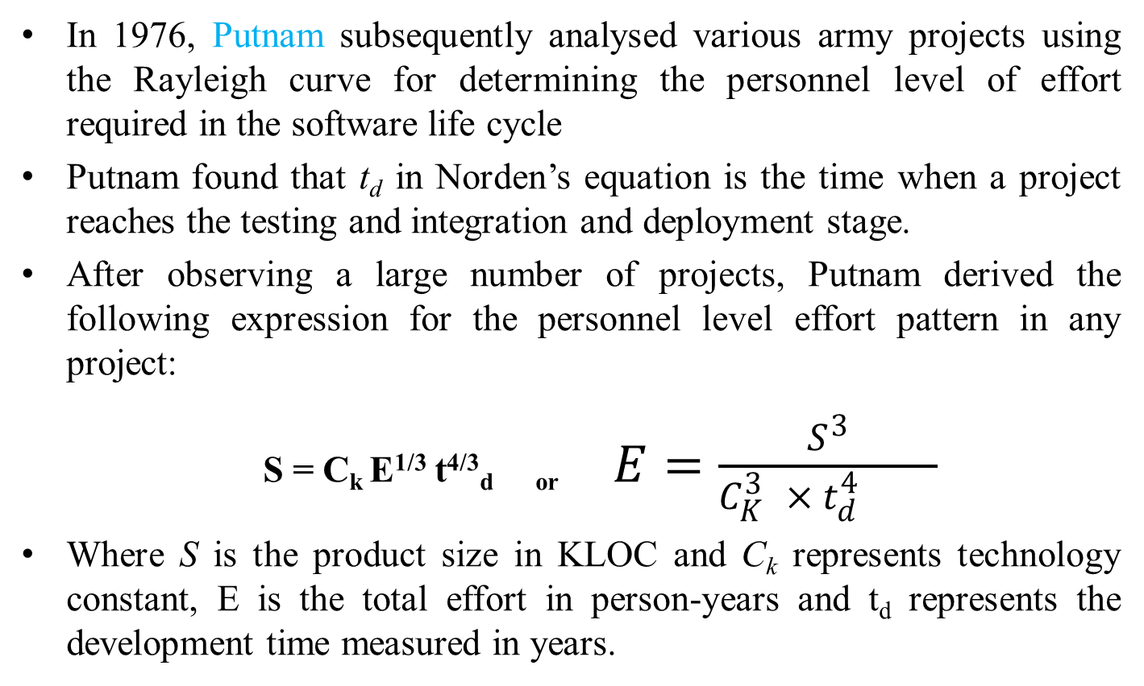
Staffing and Personnel Planning
In 1976, Putnam subsequently analysed various army projects using the Rayleigh curve for determining the personnel level of effort required in the software life cycle
Putnam found that t_{d} in Norden’s equation is the time when a project reaches the testing and integration and deployment stage.
After observing a large number of projects, Putnam derived the following expression for the personnel level effort pattern in any project:
S = C_{k} E^{1/3} t^{4/3}_{d or} $E=\frac{S^{3}}{C_{K}^{3 }× t_{d}^{4 }}$
Where S is the product size in KLOC and C_{k} represents technology constant, E is the total effort in person-years and t_{d} represents the development time measured in years.

Slide 80
Staffing and Personnel Planning
Staffing level estimation is used to determine the personnel level requirement in different tasks and phases of the development cycle.
Personnel planning concentrates on estimating and allocating the right person to the right task at the right time during project execution.
The personnel requirement is determined by dividing the total effort by the development time.
The project manager then recruits the required personnel in the project. Thereafter, the team is composed and responsibilities are allocated to the team members corresponding to their skills.

Slide 81
Project Scheduling and Milestones
A project schedule is built to answer what tasks will be accomplished when, how, and by whom.
In project scheduling, the overall effort and staff are distributed across the project duration for each task in the project.
PMBOK defines the project schedule as the planned dates for carrying out the scheduled activities and the planned dates for meeting the schedule milestones
A schedule milestone is an end point of a task while performing an activity in the process.

Slide 82
Project Scheduling and Milestones
Project scheduling activities
  Task identification
  Work breakdown structure
  Task interdependency using PERT-CPM
  Time allocation
  Resource allocation using Gantt chart
  Monitoring, tracking, and control

Slide 83
Project Scheduling and Milestones
Task Identification
Task identification focuses on identifying all the activities and tasks before considering the delivery dates and resource constraints.
The tasks are decided based upon the nature of the project, which can be a new development project, reengineering project, enhancement project, etc.
There are various factors that influence the project tasks, such as project size, project staff, project complexity, mission criticality, reengineering factors, number of potential users, requirements stability, and the maturity of technology.
Task identification begins with the mission and vision of the project. Top-down and bottom-up approaches can be used for the preparation of the task list.

Slide 84
Project Scheduling and Milestones
  Task Identification: Example
  Mission critical system
  T1 Mission critical system
    T1.1 Risk analysis
    T1.2 Prototype construction
    T1.3 Requirement analysis
    T1.4 Design
      T1.4.1 System architecture
      T1.4.2 System design
            T1.4.2.1 Input design
            T1.4.2.2 Database design
            T1.4.2.3 Output design
      T1.4.3 Detailed design
    T1.5 Coding
    T1.6 Testing
        T1.6.1 Unit test
        T1.6.2 Integration test
        T1.6.3 System test
          T1.6.3.1 Stress testing
          T1.6.3.2 Performance testing
          T1.6.3.3 Volume testing
          T1.6.3.4 Security testing
        T1.6.4 Acceptance testing
    T1.7 Deployment

Slide 85
Project Scheduling and Milestones
Work Breakdown Structure
The work breakdown structure (WBS) shows the project details of tasks, making it easier to understand and communicate them throughout the project life cycle.
The WBS represents a hierarchical breakdown of a project into elements.
The total work of the project is divided into manageable elements with increasing levels of detail.
The upper levels of the WBS are typically major deliverables of the project.
The lower levels are the refinements of the upper level.
A properly structured WBS helps to improve the accuracy of cost estimates by estimating the costs of the lower-level elements.
It provides a mechanism for performance measurement and control level by level.

Slide 86
Project Scheduling and Milestones
Work Breakdown Structure for Mission Critical System
Mission critical system
Risk
Prototype
Requirement
Design
Coding
Testing
Deployment
a
nalysis
construction
analysis
System
System
Detailed
Unit
System
Integration
Acceptance
architecture
design
design
testing
testing
testing
testing
Input
Output
D
atabase
Stress
Performance
Recovery
testing
t
design
design
design
testing
esting
Figure 4.4: Work breakdown structure

Slide 87
Project Scheduling and Milestones
PERT
PERT is a project management techniques used for planning, scheduling, monitoring, and controlling project activities. It helps in estimating project duration, identifying critical activities, and managing resources.
PERT (Program Evaluation and Review Technique)
PERT is a project scheduling technique used when the duration of activities is uncertain. It uses three time estimates to calculate the expected duration of each activity.

Slide 88
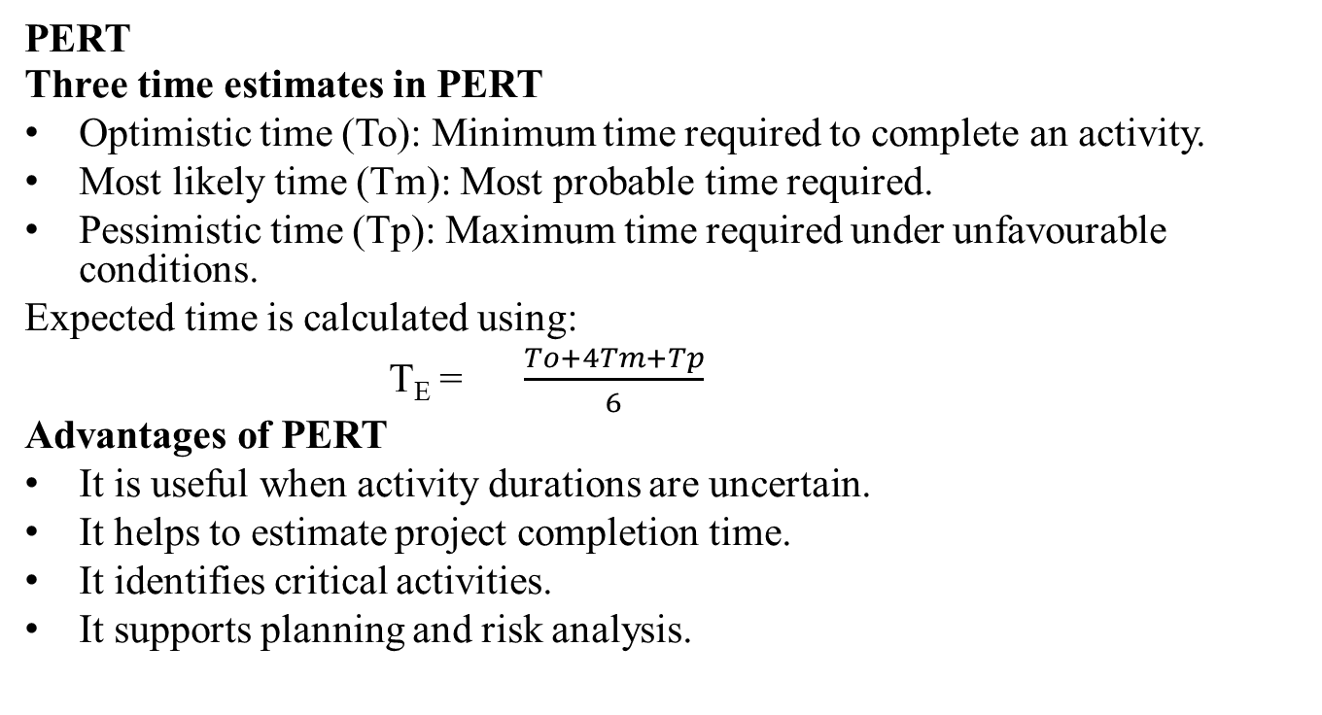
Project Scheduling and Milestones
PERT
Three time estimates in PERT
Optimistic time (To): Minimum time required to complete an activity.
Most likely time (Tm): Most probable time required.
Pessimistic time (Tp): Maximum time required under unfavourable conditions.
Expected time is calculated using:
T_{E} = $\frac{To+4Tm+Tp}{6}$
Advantages of PERT
It is useful when activity durations are uncertain.
It helps to estimate project completion time.
It identifies critical activities.
It supports planning and risk analysis.

Slide 89
Project Scheduling and Milestones
CPM (Critical Path Method)
CPM is a project scheduling technique used to determine the longest path of dependent activities in a project. This path is called the critical path and determines the minimum project completion time.
CPM generally uses a single time estimate for each activity.
Important terms in CPM
Critical path: The longest-duration path through the project network.
Critical activity: An activity with zero total float; delaying it delays the project.
Float or slack: The time an activity can be delayed without affecting the specified project completion date.
Earliest Start (ES): Earliest time an activity can begin.
Latest Start (LS): Latest time an activity can begin without delaying project completion.
Total float is calculated as:
Total Float = LS-ES
Alternatively,
Total Float = LF-EF
where LF is Latest Finish and EF is Earliest Finish.

Slide 90
Project Scheduling and Milestones
Task interdependency using PERT-CPM
Task interdependency represents the dependency relationship or the sequence of tasks between a pair of activities.
WBS is converted into an activity network diagram (AND) that shows the task interdependency in the project.
The activity network diagram is designed using
  Project Evaluation and Review Technique (PERT)
  Critical Path Method (CPM).

Slide 91
Project Scheduling and Milestones
PERT-CPM Method
PERT is a network-based representation of tasks or activities to determine the task interdependency.
It represents the precedence or parallel relationships among the tasks in a project.
A PERT diagram has the following construction rules:
  Each task or activity is represented as a node in boxes.
  Arrow shows the dependencies between tasks or activities.
  There is a start node, which has only an outgoing arrow, and an end node, which has only incoming arrows.
  An arrow pointing to a node comes from its predecessor activity, which must be completed before a task can begin.

Slide 92
Project Scheduling and Milestones
  PERT-CPM Method
  Arrows pointing out of a task box go to its successor tasks, which cannot start until at least this task is complete.
  For example, T1 is the predecessor of T2 in the following diagram. T2 cannot start until T1 is completed.
Predecessor
Successor
T1
Time duration
T2
Task 1
Task 2

Slide 93
Project Scheduling and Milestones
  Based upon the details of WBS and the sequence of activities, an activity network diagram is drawn which shows the sequence of serial and parallel activities in the project.
  There is no cycle in the activity network diagram.
  The expected completion time in days is shown inside the nodes, along with the activities.
The duration of the project is equal to the longest path from the start to the finish node of the network.
A path in the network diagram is one of the routes following the arcs from the start to the finish node.
The length of a path is the sum of the expected estimated durations of the activities on the path.

Slide 94
Project Scheduling and Milestones
Example: Activity network diagram
Input
design, 6
Output
design, 6
Start, 0
Architectural design, 10
Database
design, 13
Finish, 0
Detailed design, 18
Figure 5.5: Activity network diagram

Slide 95
Project Scheduling and Milestones
PERT-CPM Method
The duration of the project must be at least the length of the longest path.
Thus, the estimated project duration equals the length of the longest path through the project network.
This longest path is called the critical path.
For larger projects, it may be helpful to determine the following values for each activity:
  Earliest Start time (TES): It is the earliest time an activity may begin after allowing the preceding activities to finish. Earliest start time (TES) = max (TEF of immediate predecessors).
  Earliest Finish time (TEF): It is the earliest time an activity may finish after allowing the preceding activities to finish. Earliest finish time (TEF) = TES + Activity duration.
  T_{ES} and T_{EF} are calculated in the forward pass through the network diagram.

Slide 96
Project Scheduling and Milestones
PERT-CPM Method
Sometimes activities take longer than the expected time duration that may delay project completion.
So, to determine how much late an activity can start or finish without delaying project completion as:
  Latest Start time (T_{LS}): It is the latest time an activity may begin without delaying project completion. Latest start time (T_{LS}) = T_{LF} - Activity duration.
  Latest Finish time (T_{LF}): It is the latest time an activity may finish without delaying project completion. Latest finish time = T_{LF} = min (T_{LS} of immediate successors).
  Slack time (TS): The slack time for an activity is the difference between its latest finish time and its earliest finish time. Slack time (TS) = TLF – TEF = TLS – TES.
  The backward pass through the network diagram is made starting with the final activities and moving backward in time toward the initial activities to calculate TLS and TLF.

Slide 97
Project Scheduling and Milestones
PERT-CPM Method
T_{ES} = 10
T_{EF} = 16
Input
design, 6
T_{ES} = 23
T_{EF} = 29
T_{LS} = 17
T_{LF} = 23
Output
design, 6
T_{ES}= 0
T_{EF}= 0
T_{ES} = 10
T_{EF} = 23
T_{ES} = 0
T_{EF} = 0
T_{ES} = 0
T_{EF} = 10
T_{ES} = 29
T_{EF} = 29
Start, 0
Architectural design, 10
Database
design, 13
T_{LS} = 23
T_{LF} = 29
Finish, 0
T_{LS} = 0
T_{LF} = 0
T_{LS} = 0
T_{LF} = 10
T_{LS} = 29
T_{LF} = 29
T_{LS} = 10
T_{LF}= 23
T_{ES} = 10
T_{EF}= 28
Detailed design, 18
T_{LS} = 11
T_{LF} = 29
Figure 5.6: PERT with the critical path

Slide 98
Project Scheduling and Milestones
PERT-CPM Method
There are some activities having no slack and other activities have slack time. The critical path then is the path through the network in which none of the activities have slack.
Each activity with zero slack is on the critical path through the project network such that any delay along this path will delay project completion.
The critical path is shown in Figure 4.6 with dark arrows in the network diagram.
The critical path is:
Start node > Architectural design > Database design > Output design > Finish node

Slide 99
Project Scheduling and Milestones
PERT-CPM Method
Advantage:
  PERT is useful to determine the expected project completion time, the probability of completion before a specified date, and the start and end dates.
  It helps to find the critical path activities that directly influence the completion time.
Limitation:
  The time estimates for activities are somewhat subjective and depend on judgment.
  If there is little experience in performing an activity, the time is fixed only by an educated guess.

Slide 100
Project Scheduling and Milestones
Time allocation
The project time can be estimated based on certain assumptions and the experience of estimating the likely estimates of the activities in the project.
Therefore, the estimation of time duration for a project includes three time estimates:
  Optimistic time (T_{O}): It is the shortest time in which the activity can be completed.
  Most likely time (T_{M}): It is the completion time having the highest probability.
  Pessimistic time (T_{P}): It is the longest time that an activity might require.

Slide 101
Project Scheduling and Milestones
Time allocation
The expected time for each activity can be approximated using the following weighted average:
  Expected time (T) = (T_{O} + 4 × T_{M} + T_{P})/6
This expected time might be displayed on the network diagram along with the activities in boxes.
The variance for each activity is determined as:
  [(T_{P} - T_{O})/6]²
The variance in the total project durations is the sum of the variances of the activity duration on the critical path.
This is helpful for project managers in determining the completion time of the project.

Slide 102
Project Scheduling and Milestones
Resource allocation
A Gantt chart is a horizontal bar chart that provides a graphical illustration of a project schedule.
It is commonly used for scheduling the tasks, allocating the resources, and tracking the progress of projects.
Drawing a Gantt chart requires tasks, duration of the tasks, and resources requirements to complete the tasks. Gantt charts are also useful for monitoring the progress of the project.
In a Gantt chart, activities are generally shown vertically on the left-hand side and the horizontal bar indicates the start date, end date, and duration of each activity.

Slide 103
Project Scheduling and Milestones
Resource allocation
Task name | Duration (days) | Start date | End date | Jan Jan Feb Feb 20 31 10 20
Architectural design | 10 | 20/01/11 | 29/01/11
Input design | 6 | 31/01/11 | 05/02/11
Database design | 13 | 31/01/11 | 12/02/11
Output design | 6 | 13/02/11 | 18/02/11
Detailed design | 18 | 31/01/11 | 17/02/11
Figure 5.7: Gantt chart for software design

Slide 104
Project Scheduling and Milestones
Monitoring, Tracking, and Control
There are several methods for monitoring, tracking, and controlling the project activities.
Some automated tools such as Microsoft Project, SMART etc., are also used for monitoring the projects.
The most popular methods used for project monitoring and tracking are
  Review meetings,
  Cost-schedule milestone graphs,
  Status reporting,
  Earn value methods, and so on.

Slide 105
Project Scheduling and Milestones
Monitoring, Tracking, and Control
Review meetings
  Review meetings are conducted to ensure that the planned schedule is executed within time and appropriate resources.
  Project managers conduct review meetings regularly to check the status of all the tasks specified in the Gantt chart.
Status reporting
  In status reporting, each member of the project records the status of their assigned tasks.
  The project manager calls periodical project status meetings and each member reports the current status of the tasks.
  The problems faced by the team members are discussed in the status meeting. The project status meeting is generally called weekly or quarterly.

Slide 106
Project Scheduling and Milestones
Monitoring, Tracking, and Control
Cost-schedule milestone graph
  The cost-schedule milestone graph is a graphical representation of the progress of a project.
  The project progress is measured monthly or at the interval decided by the project manager through the cost estimated against the planned schedule.
  At each milestone, the actual cost is compared with the schedule. A variation represents the fluctuation in the planned cost and planned schedule.

Slide 107
Project Scheduling and Milestones
Monitoring, Tracking, and Control
Earn value analysis
  The earn value analysis is a quantitative analysis to determine the progress of a project.
  Each task is given an earn value, i.e., the effort decided during project planning in the ratios of the project size.
  The earn value of each task is summed and thus it is the total cost that is estimated.
  This value is compared with the actual cost reported in the cost-schedule or status reporting document.
  The project manager can find the progress of the project and the deviation in the cost or schedule.

Slide 108
Miscellaneous Plans
  Planning for the development life cycle
  Configuration management plan
  Risk management plan
  Quality assurance plan
  System testing plan
  Deployment plan

Slide 109
Summary
Project planning is necessary for devising resources and budgets, for monitoring and controlling the activities of project management.
There are various units of size measurement, such as lines of code (LOC), function point (FP), token count (TC), fuzzy logic sizing, object point (OP), standard component sizing, etc.
The most popular estimation techniques are estimation by analogy, Delphi estimation, algorithmic cost modelling, and analytical technique. Project scheduling is an important responsibility performed by project managers in order to complete the project in a successful manner.
These plans are the selection of the development life cycle, configuration management plan, risk management plan, quality assurance plan, system testing plan, and deployment plan.

